Slide 1
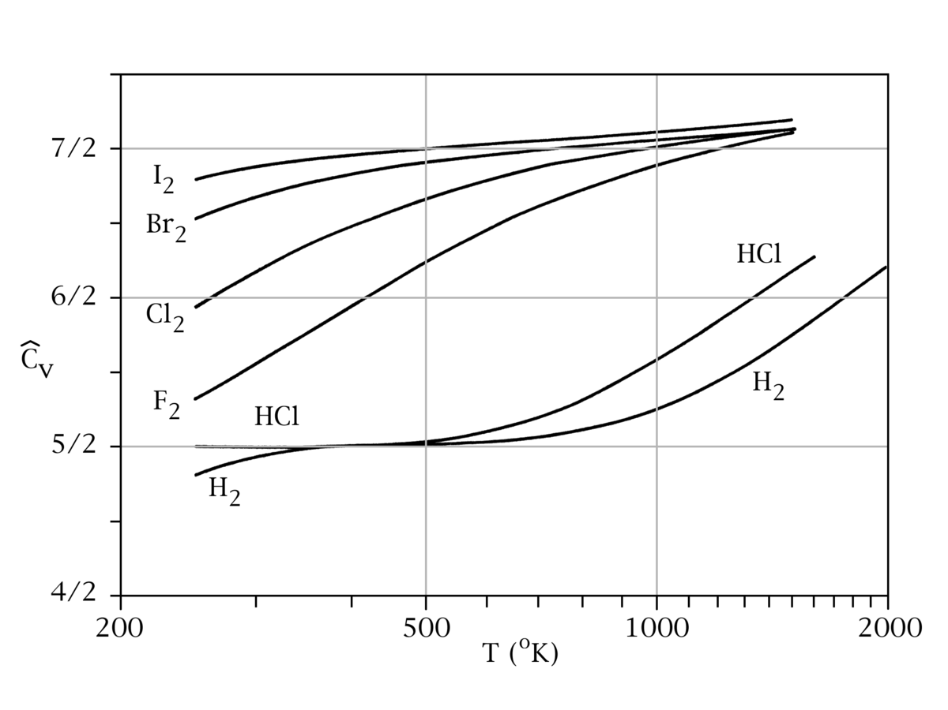
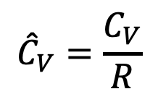
Why this trend going from $I_{2}$ down to $H_{2}$?
$${\hat{C}}_{V}=\frac{C_{V}}{R}$$

Slide 2

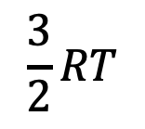


Temperature is high enough for $I_{2}$ to vibrate, but not the others
$$\frac{3}{2}RT$$
$$I_{2}$$
$$F_{2}$$
$$H_{2}$$

Slide 3
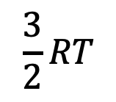
Temperature is high enough for $I_{2}$ and $F_{2}$to vibrate, but not $H_{2}$
$$\frac{3}{2}RT$$
$$I_{2}$$
$$F_{2}$$
$$H_{2}$$

Slide 4
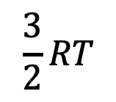
Temperature is high enough for all of them to vibrate
$$\frac{3}{2}RT$$
$$I_{2}$$
$$F_{2}$$
$$H_{2}$$

Slide 5
Interpreting U(T,V)
Ideal gas molecules don’t see each other. That means there can’t be any volume dependence of the internal energy on volume. In contrast, real gases have intermolecular interactions (esp. at low volume).
Translational and rotational parts of the internal energy are linear functions of $T$ (like $\frac{3}{2}RT$), but vibrational contributions tend to be nonlinear functions of $T$ (i.e., curved).

Slide 6
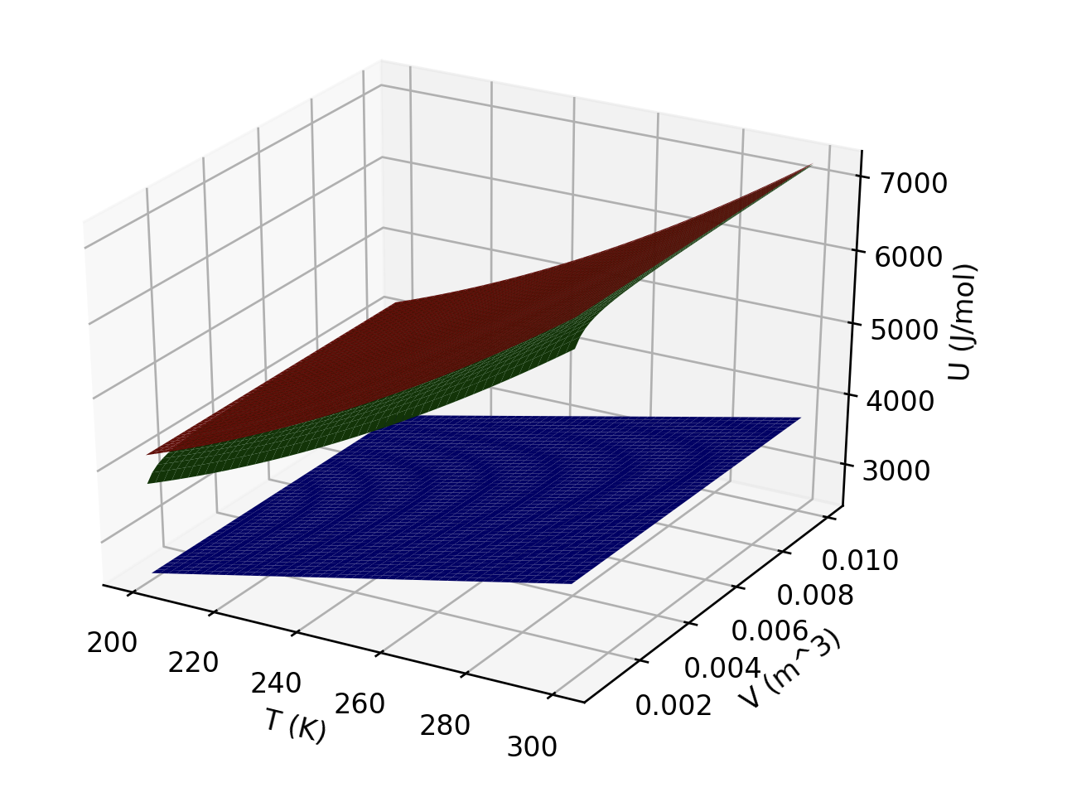
Interpreting U(T,V)
Which of these three gases could be ideal?
Which could be a monatomic gas?

Slide 7
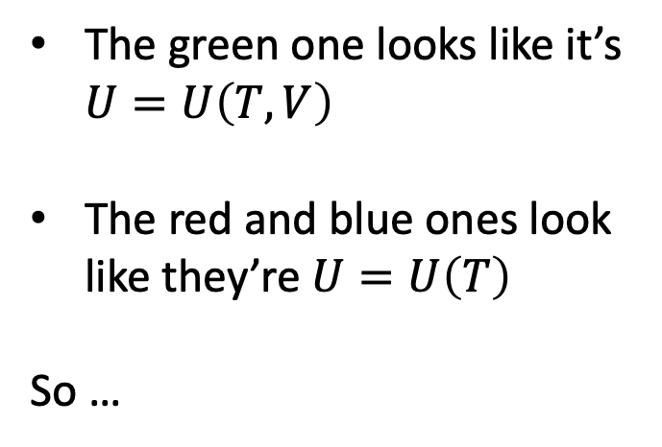
Interpreting U(T,V)
The green one looks like it’s $U=U\left(T,V\right)$
The red and blue ones look like they’re $U=U\left(T\right)$
So …

Slide 8
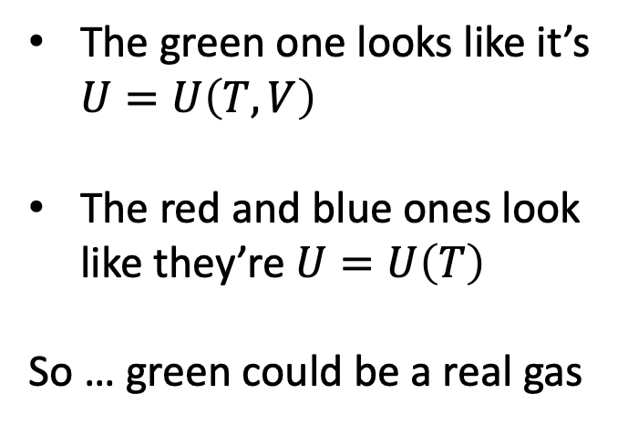
Interpreting U(T,V)
The green one looks like it’s $U=U\left(T,V\right)$
The red and blue ones look like they’re $U=U\left(T\right)$
So … green could be a real gas

Slide 9
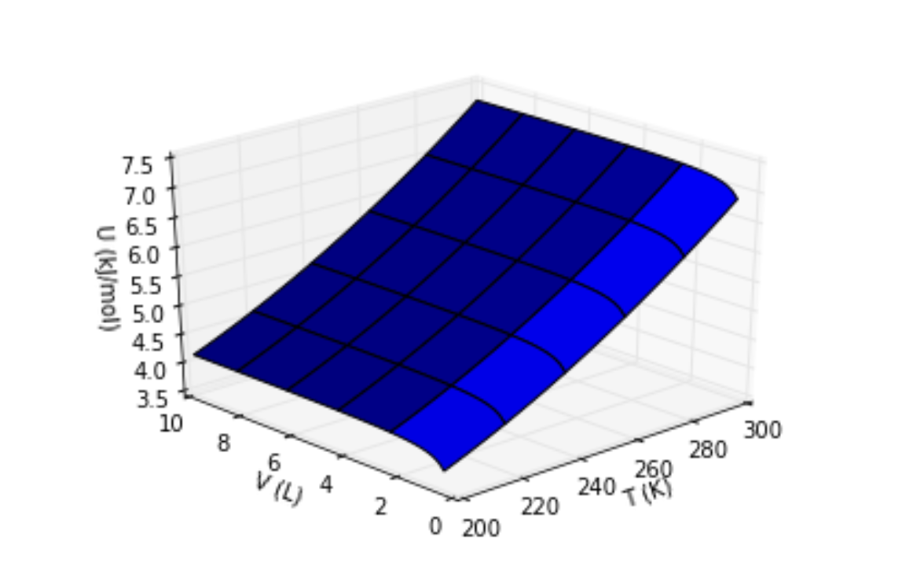
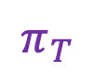
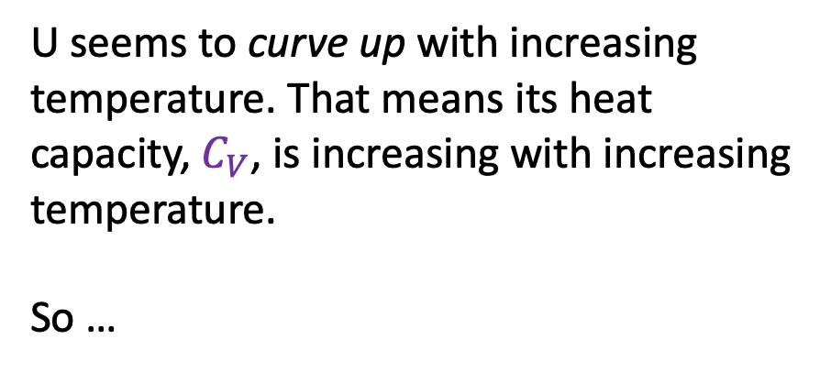
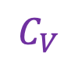
Interpreting the behavior of U in the temperature direction
$$π_{T}$$
$$C_{V}$$
U seems to curve up with increasing temperature. That means its heat capacity, $C_{V}$, is increasing with increasing temperature.
So …

Slide 10
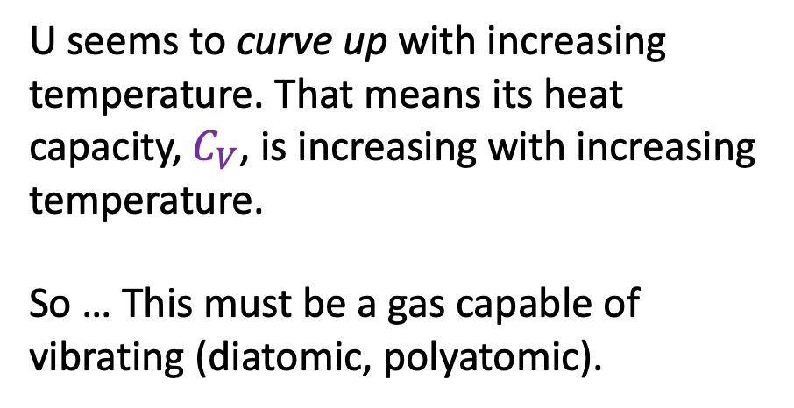
Interpreting the behavior of U in the temperature direction
$$π_{T}$$
$$C_{V}$$
U seems to curve up with increasing temperature. That means its heat capacity, $C_{V}$, is increasing with increasing temperature.
So … This must be a gas capable of vibrating (diatomic, polyatomic).

Slide 11
Interpreting U(T,V)
What kind of gas (real/ideal, monatomic or polyatomic) could this one be?

Slide 12
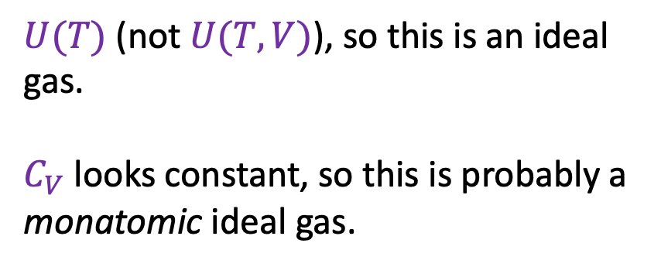
Interpreting U(T,V)
$U(T)$ (not $U(T,V)$), so this is an ideal gas.
$C_{V}$ looks constant, so this is probably a
monatomic ideal gas.
What kind of gas (real/ideal, monatomic or polyatomic) could this one be?

Slide 13
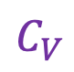
Interpreting the behavior of U in the volume direction
$$π_{T}$$
$$C_{V}$$

Slide 14
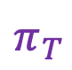
Interpreting the behavior of U in the volume direction
$$π_{T}$$
$$C_{V}$$
Why does U dip down at small volumes?

Slide 15
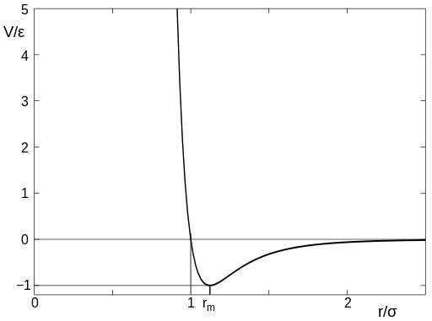
Interpreting the behavior of U in the volume direction
$$π_{T}$$
$$C_{V}$$
Why does U dip down at small volumes?
Potential Energy
Real
d
Region of negative intermolecular potential energy

Slide 16
Why U goes up with increasing volume at a given temperature (for a real/vdw gas)
Intermolecular attractions

Slide 17
Why U goes up with increasing volume at a given temperature (for a real/vdw gas)
Intermolecular attractions

Slide 18
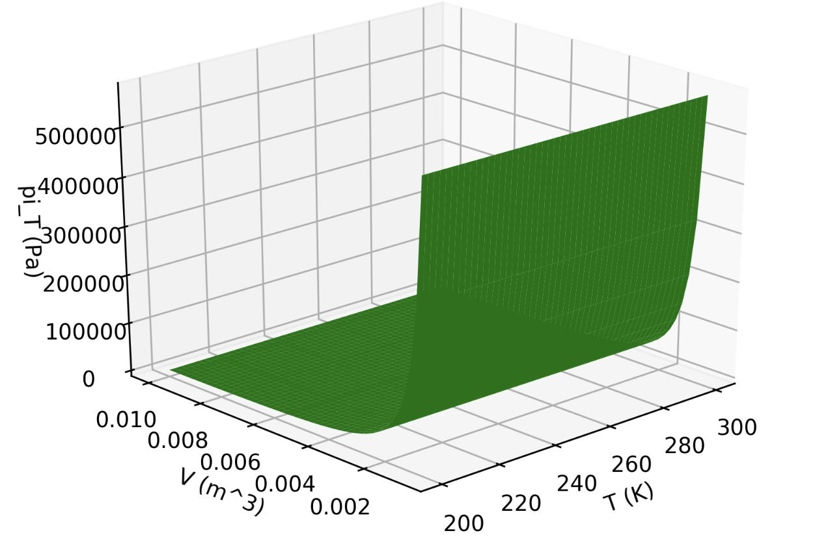
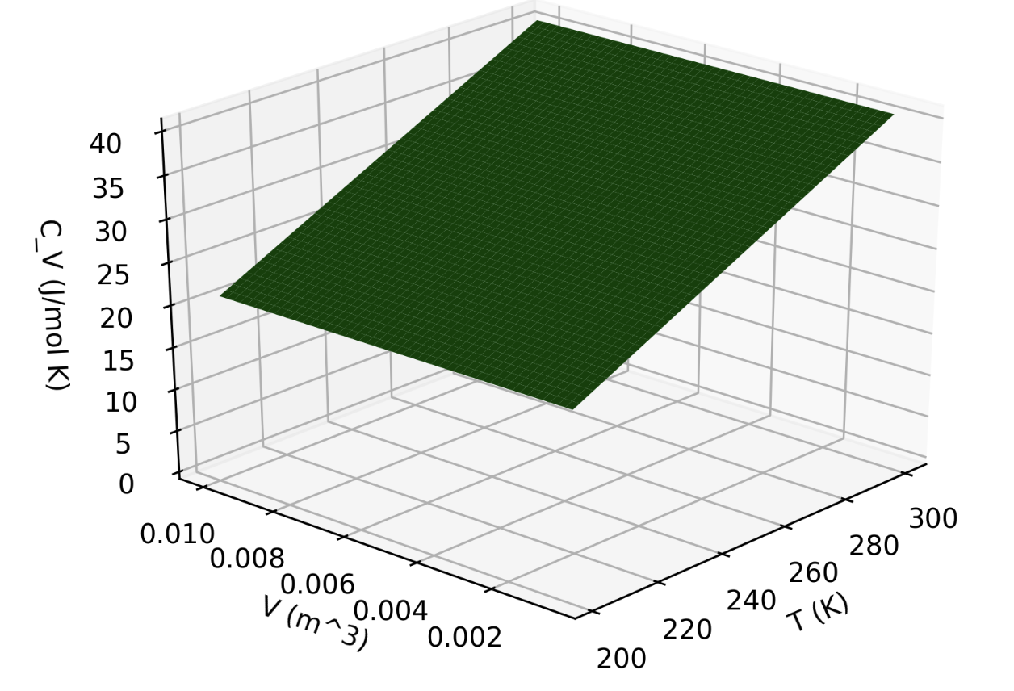
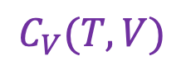
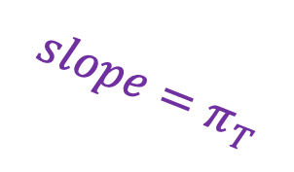
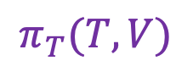

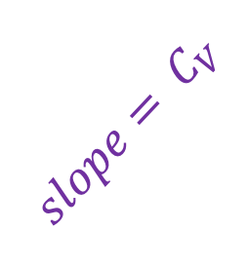
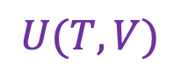
Differential calculus gets us $C_{V}$ and $π_{T}$
$$π_{T}(T,V)$$
$$U(T,V)$$
$$slope=π_{T}$$
$${slope= C}_{V}$$
$$C_{V}(T,V)$$

Slide 19
Numerical method to find $C_{V}$ and $π_{T}$
If you have a discrete representation of $U(V,T)$, you can take a numerical derivative in Python (using dF_dx and dF_dy).

Slide 20
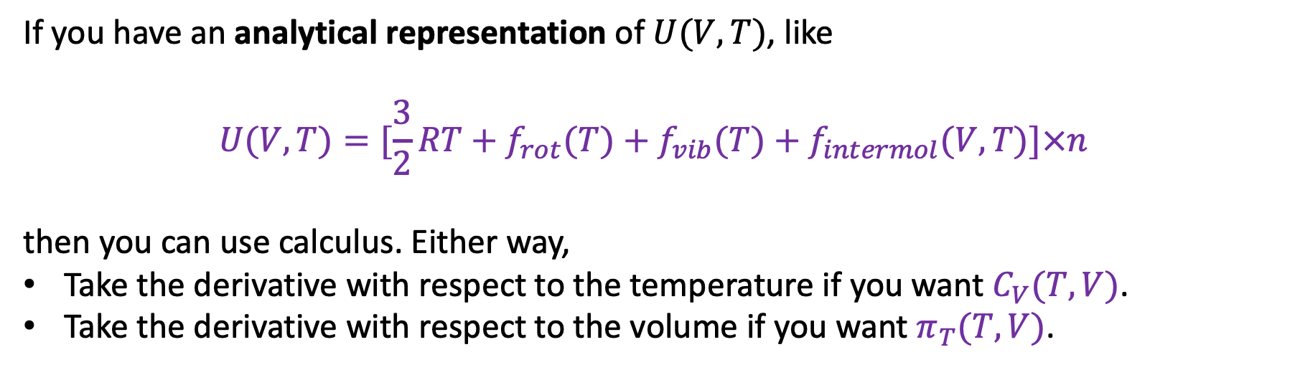
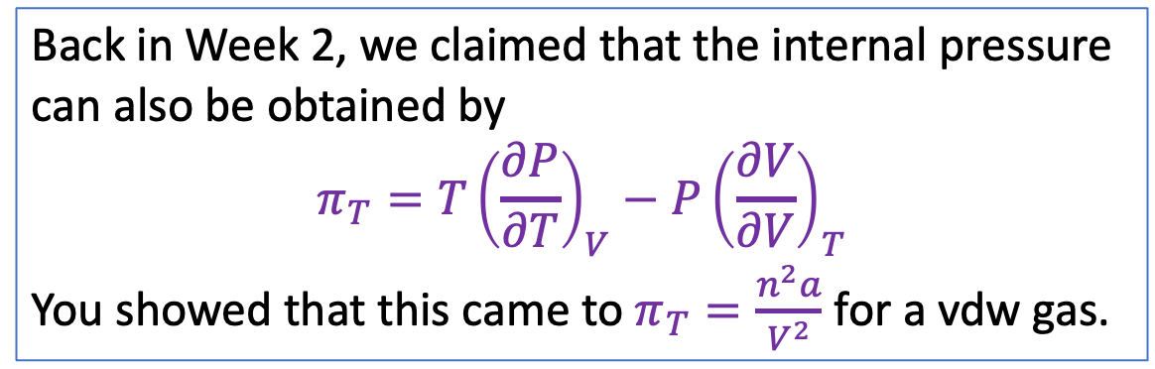
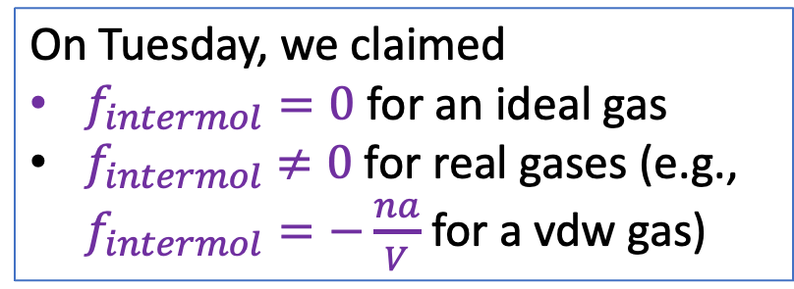
Analytical method to get $C_{V}$ and $π_{T}$
If you have an analytical representation of $U(V,T)$, like
$$U(V,T)=[\frac{3}{2}RT+f_{rot}(T)+f_{vib}(T)+f_{intermol}(V,T)]×n$$
then you can use calculus. Either way,
Take the derivative with respect to the temperature if you want $C_{V}(T,V)$.
Take the derivative with respect to the volume if you want $π_{T}(T,V)$.
On Tuesday, we claimed
$f_{intermol}=0$ for an ideal gas
$f_{intermol}$ $≠0$ for real gases (e.g., $f_{intermol}=−\frac{na}{V}$ for a vdw gas)
Back in Week 2, we claimed that the internal pressure can also be obtained by
$$π_{T}=T{\left(\frac{∂P}{∂T}\right)}_{V}−P{\left(\frac{∂V}{∂V}\right)}_{T}$$
You showed that this came to $π_{T}=\frac{n^{2}a}{V^{2}}$ for a vdw gas.
Can you reconcile these two claims?

Slide 21
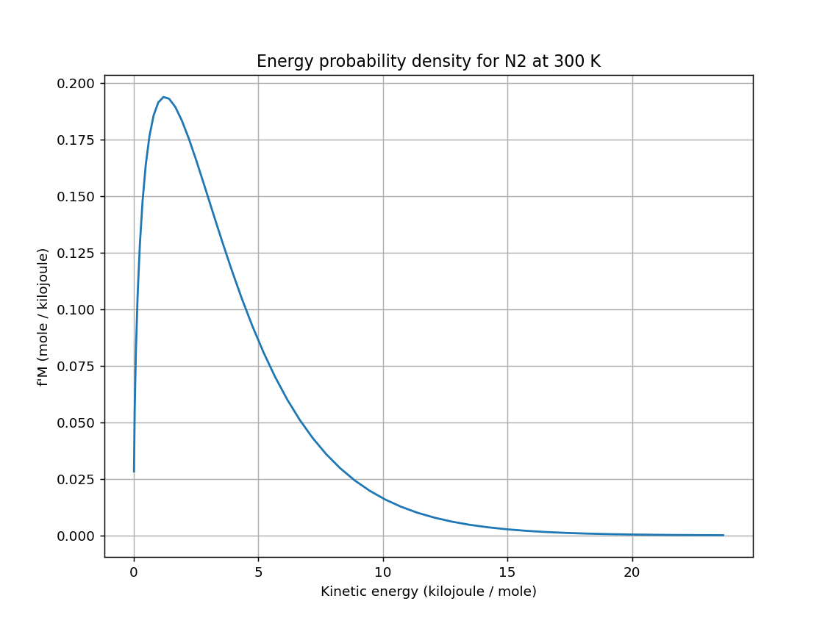
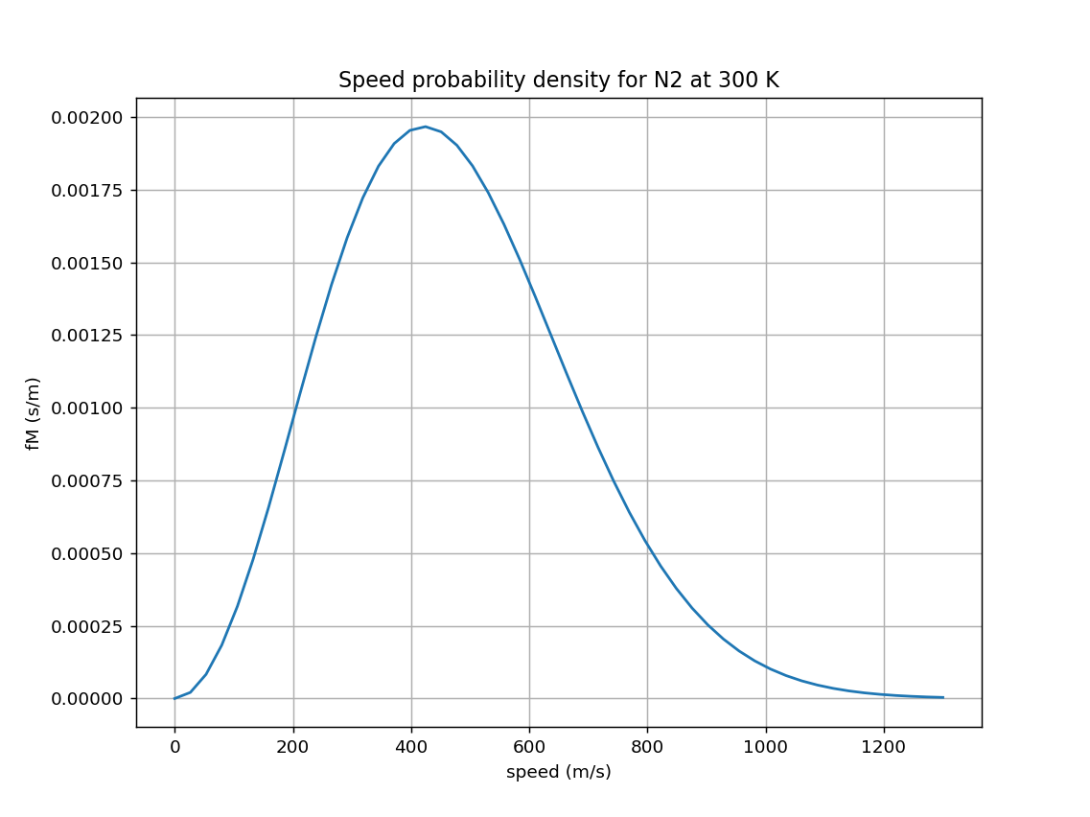
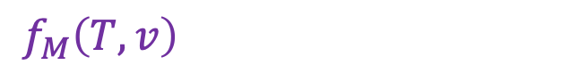
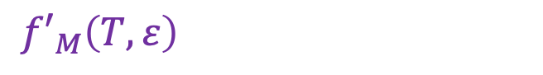
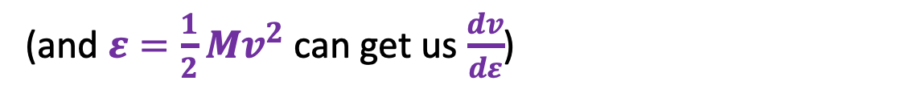
Transforming from one probability density to another
OK … what if we wanted to think about all this in terms of kinetic energy instead of speed?
${f′}_{M}\left(T,ε\right)=f_{M}\left(T,v\right)\frac{dv}{dε}$
$f_{M}\left(T,v\right)$
${f′}_{M}\left(T,ε\right)$
$$∆ε$$
$$∆v$$
(and $ε=\frac{1}{2}Mv^{2}$ can get us $\frac{dv}{dε}$)

Slide 22
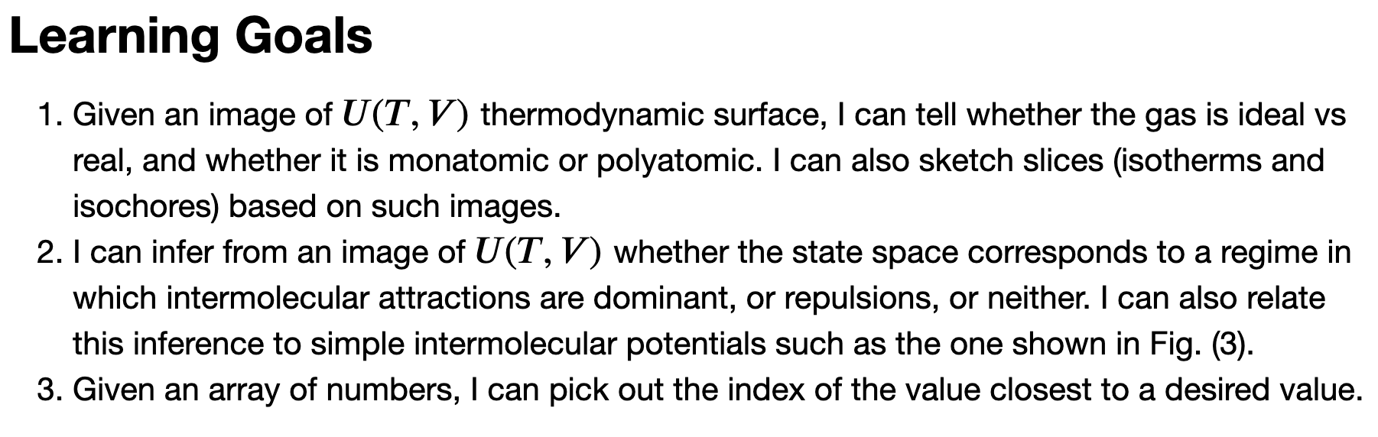
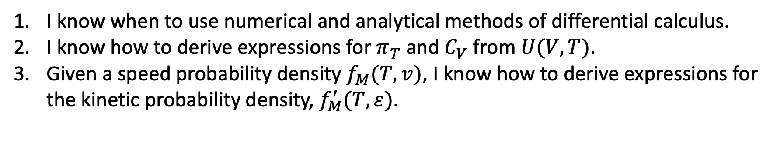
Take-homes from today …
I know when to use numerical and analytical methods of differential calculus.
I know how to derive expressions for $π_{T}$ and $C_{V}$ from $U(V,T)$.
Given a speed probability density $f_{M}(T,v)$, I know how to derive expressions for the kinetic probability density, $f_{M}^{′}(T,ε)$.

Slide 23
Next week
1-on-1 interviews
CGI on an ice-free Arctic

Slide 24
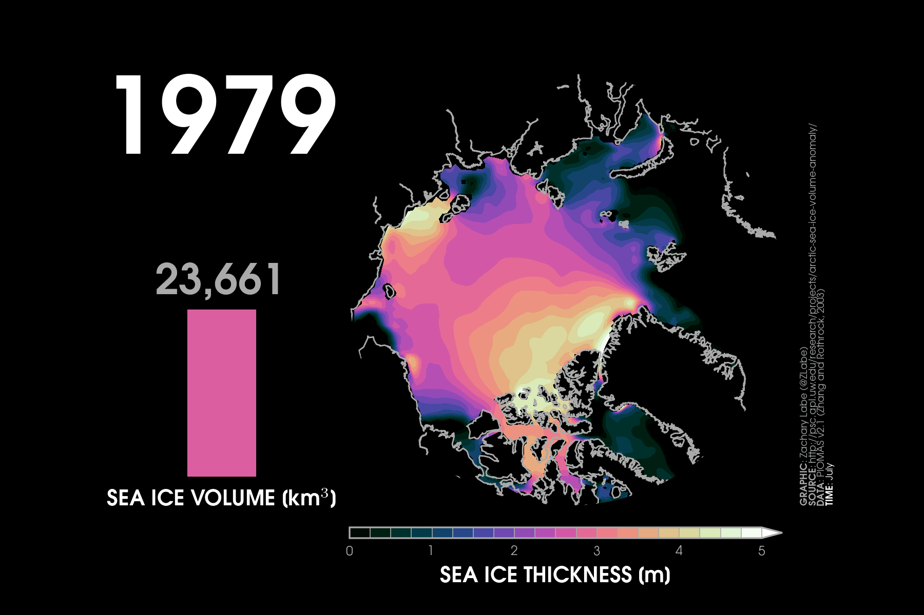
And in the north, coming sooner than we thought: an ice-free summertime Arctic Ocean
We used to think that the first time Arctic sea ice will go entirely away will be some summer in the 2050s (or even later), and after that an infrequent occurrence.
*https://www.nature.com/articles/s41467-023-38511-8
*http://www.climatecodered.org/2023/06/dramatic-arctic-sea-ice-news-should-not.html
https://zacklabe.files.wordpress.com/2023/08/sit_piomas_jul23.gif

Slide 25
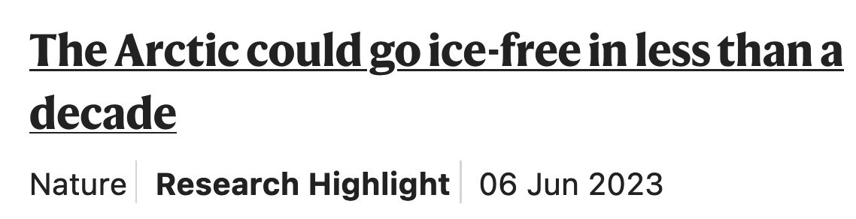
And in the north, coming sooner than we thought: an ice-free summertime Arctic Ocean
We used to think that the first time Arctic sea ice will go entirely away will be some summer in the 2050s (or even later), and after that an infrequent occurrence.
*https://www.nature.com/articles/s41467-023-38511-8
*http://www.climatecodered.org/2023/06/dramatic-arctic-sea-ice-news-should-not.html
https://zacklabe.files.wordpress.com/2023/08/sit_piomas_jul23.gif

Slide 26
And in the north, coming sooner than we thought: an ice-free summertime Arctic Ocean
We used to think that the first time Arctic sea ice will go entirely away will be some summer in the 2050s (or even later), and after that an infrequent occurrence.
The last ice-free Arctic summer was ~130,000 years ago, when parts of the Greenland ice sheet went away and the West Antarctic Ice Sheet slipped into the ocean, bringing meters of sea level rise.
*https://www.nature.com/articles/s41467-023-38511-8
*http://www.climatecodered.org/2023/06/dramatic-arctic-sea-ice-news-should-not.html
https://zacklabe.files.wordpress.com/2023/08/sit_piomas_jul23.gif

